Slide 1
Optimizing RIDE Sharing allocation
Analysis on Ridership Allocation for Transportation Network Providers (Uber/Lyft/Via, etc.)
Presented by:
Duo zhou, Amily huang, bowen zhao, AND Yiheng Zhu

Slide 2




MEET THE TEAM
Duo Zhou
Amily Huang
Yiheng Zhu
Bowen Zhao
CEO/Founder,
Data engineer
Cto/founder,
Data engineer
COO/FOUNDER,
Data scientist
CMO/FOUNDER,
Data scientist
zd0009@uchicago.edu
yunh@uchicago.edu
yihengzhu@uchicago.edu
bowen93@uchicago.edu

Slide 3
content
Executive Summary
Data Source and Tools
Design Considerations
Results
Future Work
Recommendations

Slide 4
EXECUTIVE SUMMARY

Slide 5
Executive Summary
Our goal is to optimize vehicle allocation according to ridership demand and give business insights and recommendations to TNP companies (also called rider sharing companies like Uber, Lyft and Via).
We use data regarding weather, major sport events, public safety, and census to analyze customer behavior and to give precise recommendations.
We create a relational database system that can efficiently load, store, and extract data from different sources for analysis.
Notes:
which is essential to the success of Transportation Network Providers (TNP) (Rideshare Companies)
Ridership demand can be greatly affected by, and many other factors.

Slide 6
Business Use Case
Actor | Incentive | Business Use
TNP | To better understand customer behavior Vehicle allocation Optimization Improve customer service management | Understand how different factors impact ridership and customer behavior
Driver | Maximize income per unit time | Understand how tips vary in different circumstances
Customer | Time-efficient and safer service | Improvement of service experience with better vehicle allocation and customer service

Slide 7
Data source and tools

Slide 8





Solution overview: Data / Tools
Main dataset:
Data Processing:
Visualizations:
Transportation Network Providers – Trips by Location, Distance, Day/Time, Tips, etc.
Tableau
Python:
Matplotlib
Seaborn
ggplot
Plotly
Python
- Data Cleaning and Processing
Excel
- Data Cleaning and Processing
UChicago RCC
- Cloud Computing for Large Datasets
Supporting dataset:
Data Connectors:
Weather
– Historical Weather Conditions, Short-term Forecasts
CSV Extracts
Python
- WebScraping
NoAA
- API
Geography
– Community area boundaries in Chicago
Sports Event
– Chicago sports team (NBA,NFL,MLB) schedules
Analytics:
Python:
Data Analysis
Census & Crime
– Income, Education, Crime Rate by CCA

Slide 9
DATA PREPARATION
Data Source | Format and Size | Processed Data That Meet Analytical Needs | Platform and Tools Used
Chicago Data Portal: Transportation Network Providers | 70 GB (129 Million Rows, 21 Columns) Structured CSV File | Ridership, Avg Traveled Distance, Avg Tips and Number of Pooled trips Group by CCA, Date and Time | Python, MySQL GCP and RCC
Chicago Data Portal: Boundaries - Chicago Community Areas (CCA) | 1.92 MB Structured CSV File | MULTIPOLYGON Data by CCA For Tableau | Python and Excel
Census Data By CCA | 1.1 MB Structured CSV File | Education, Age, Income, population & Unemployment Rate etc. by CCA | Python, MySQL
Chicago Data Portal: Crimes | 16 GB (7.12 Million Rows, 22 Columns) Structured CSV File | Total Number of Crimes By CCA | Python, MySQL GCP and RCC
ESPN | 2 MB Unstructured Data: From Web Scraping | Only the Home game dates and location | Python and Excel
National Centers for Environmental Information | 5.5 MB Structured CSV File | Avg daily temp, total daily precipitation and avg daily wind speed by date. | Python and Excel
Wikipedia: Community Areas in Chicago | 0.1 MB Unstructured Data: From Web Scraping | Chicago community area code | Python and Excel

Slide 10
DATA MODELING
Compiling Data into Tables
We used MySQLWorkbench to create our dimensional table. Sports and weather tables are indexed by Date (primary key), Census and Crime tables are indexed by Chicago Community Areas(CCA) (primary key). Date and CCA are both linked to the fact table as foreign key.
Data Transformations
All data are transformed into a rows and columns format with appropriate data type.
Data Mapping
We have one main dataset (fact table with ridership measures) and four supporting datasets (dim tables). A star type dimensional model is adapted by linking 4 dimensional datasets to the main fact dataset using either DATE or CCA.
Main dataset ridership measures are aggregated and grouped by CCA, date and time.
Sports schedule datasets, and weather datasets are aggregated and grouped by date.
Census and Crime datasets are aggregated and grouped by CCA.
CCA Geographic boundaries data are transformed to meet tableau virtualization requirement
Note: Ridership By Hours of A Day is an independent analytical entity that provides additional business insights on ridership, tip and Shared Trips.

Slide 11
Data Considerations

Slide 12
DESIGN CONSIDERATIONS
Data Types
id: INT
Date: DATE
CCA: INT
MEAN & MEDIAN attributes: DOUBLE
Others: INT
Dealing with NAs
Weather: Drop NA rows
Main Dataset: Fill NA with 0
Using Dimensional Tables
- Maintain historical information for any dimension
- Less processing time and higher performance
Expected Output of Data Analysis (Data Quality Metrics)
- The relationship between income level and ridership
- The impact of ridership on different weather
- The impact of ridership during major sports event
- The relationship between public safety and ridership

Slide 13
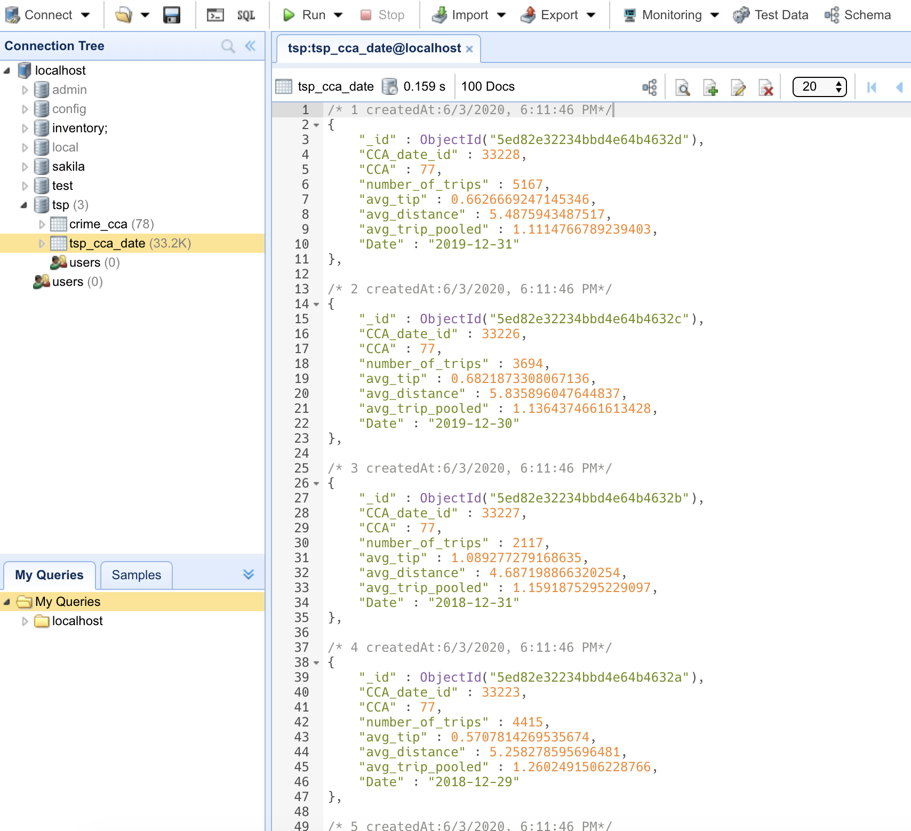

NoSQL Considerations -MONGODB, NEO4J
MongoDB
Creates document based OLTP database with each real-time trip as a transaction
* JSON file: each object contains measures from fact table and sub-arrays with information from dimension tables
Neo4j
Creates graphic based OLTP with each real-time trip as a transaction
Advantages
Easily store new data (update quarterly)
Flexible Schema
→ In this project, we focus on OLAP database

Slide 14
Completeness: Missing Values in Weather Dataset treated as zero
Validity: Data is transformed into fact and dimensions to meet our analytical need
Uniqueness: No duplicate data
Consistency: Data format is consistent throughout the database
Timeliness: The data represent reality in time as data consist all the entries over the period considered
Accuracy: Data is simply aggregated by summing and averaging over locations and dates, and this transformation can accurately represent reality
Data Quality Dimension

Slide 15
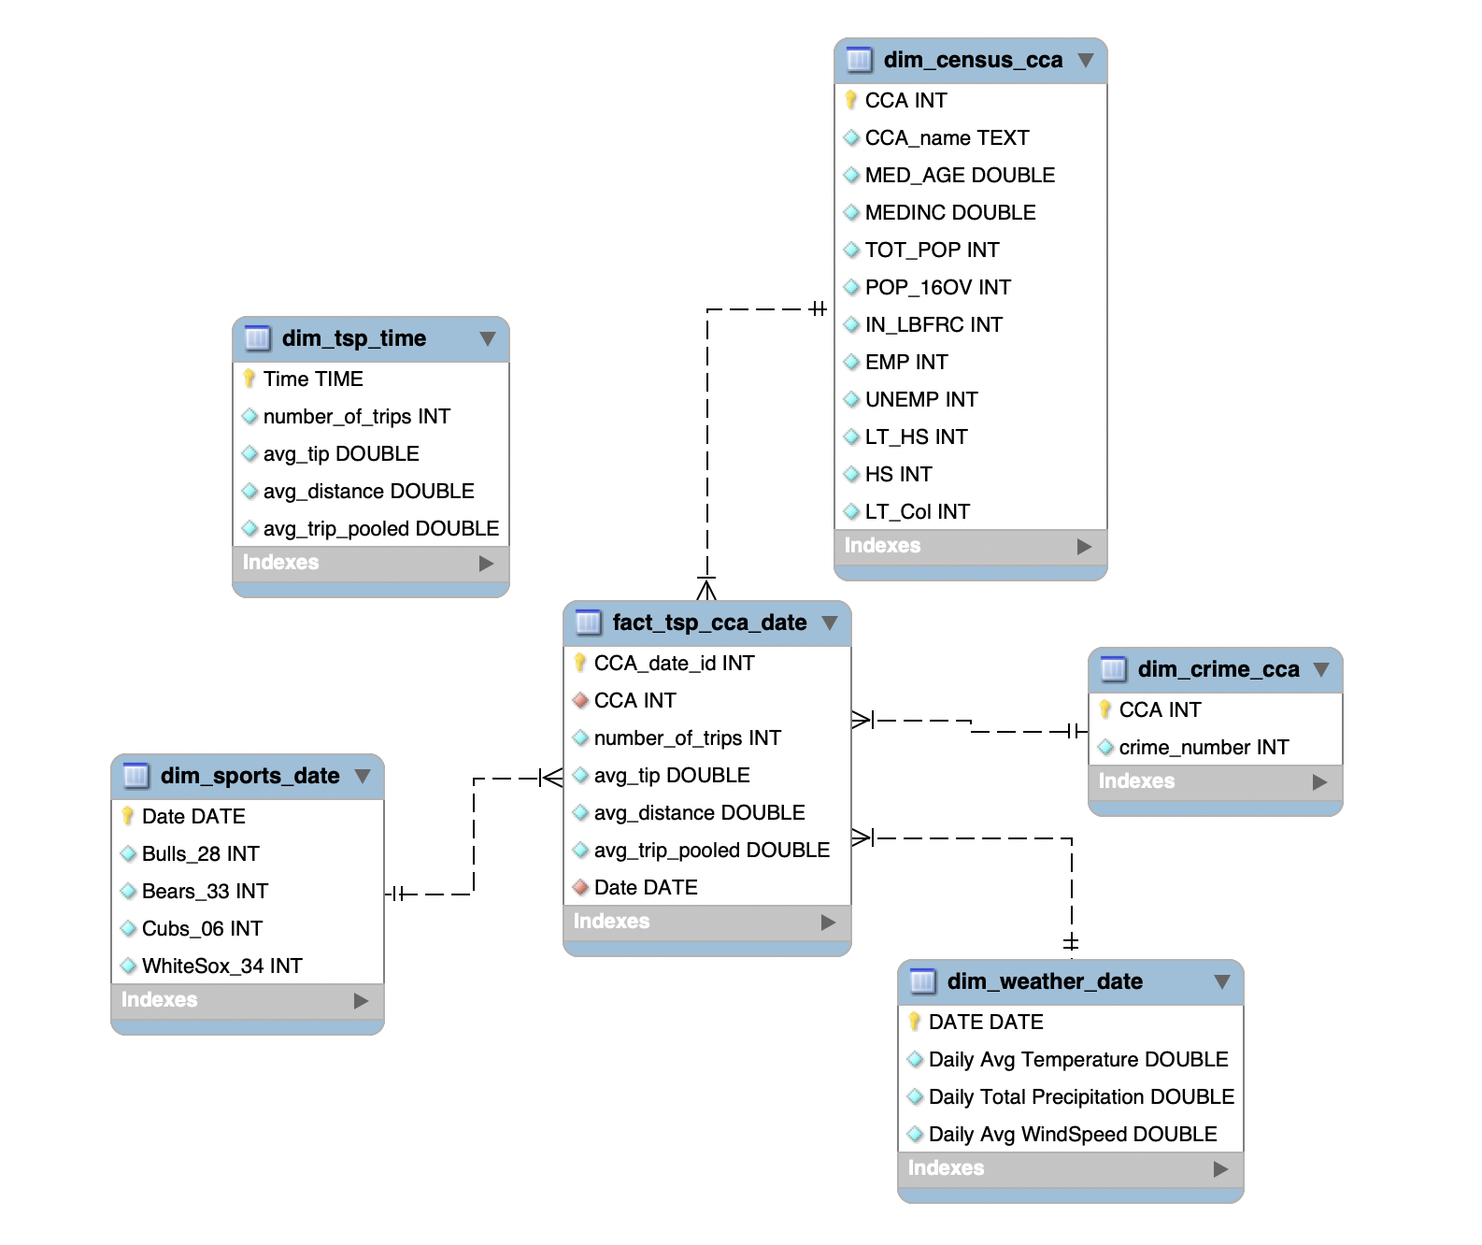
Enhanced Entity Relationship diagram
Notes: dim_tsp_time table is an independent table to analyze the ridership within a day.

Slide 16
RESULTS

Slide 17
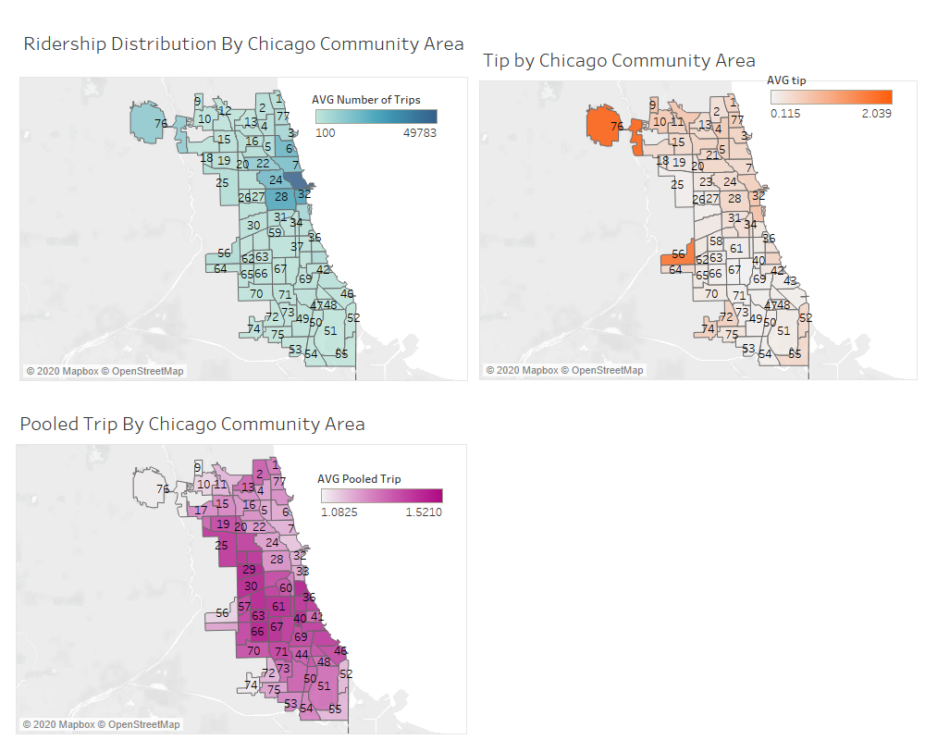
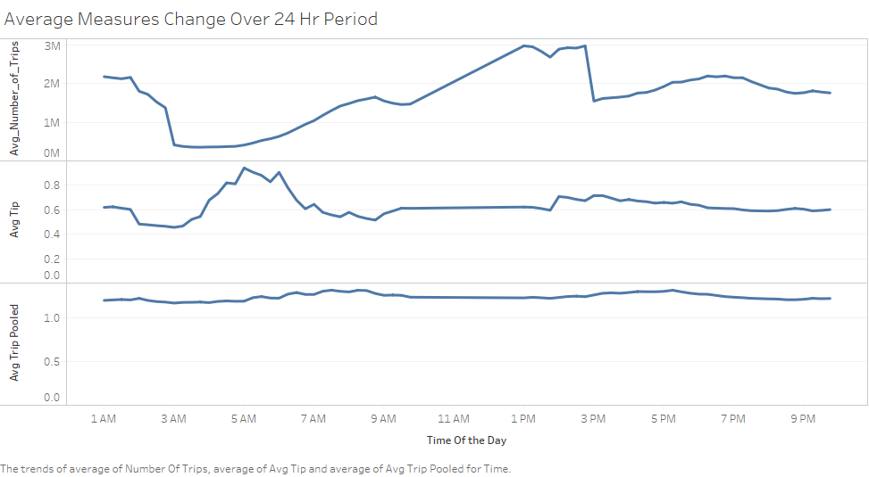
Dashboard: xxx

Slide 18
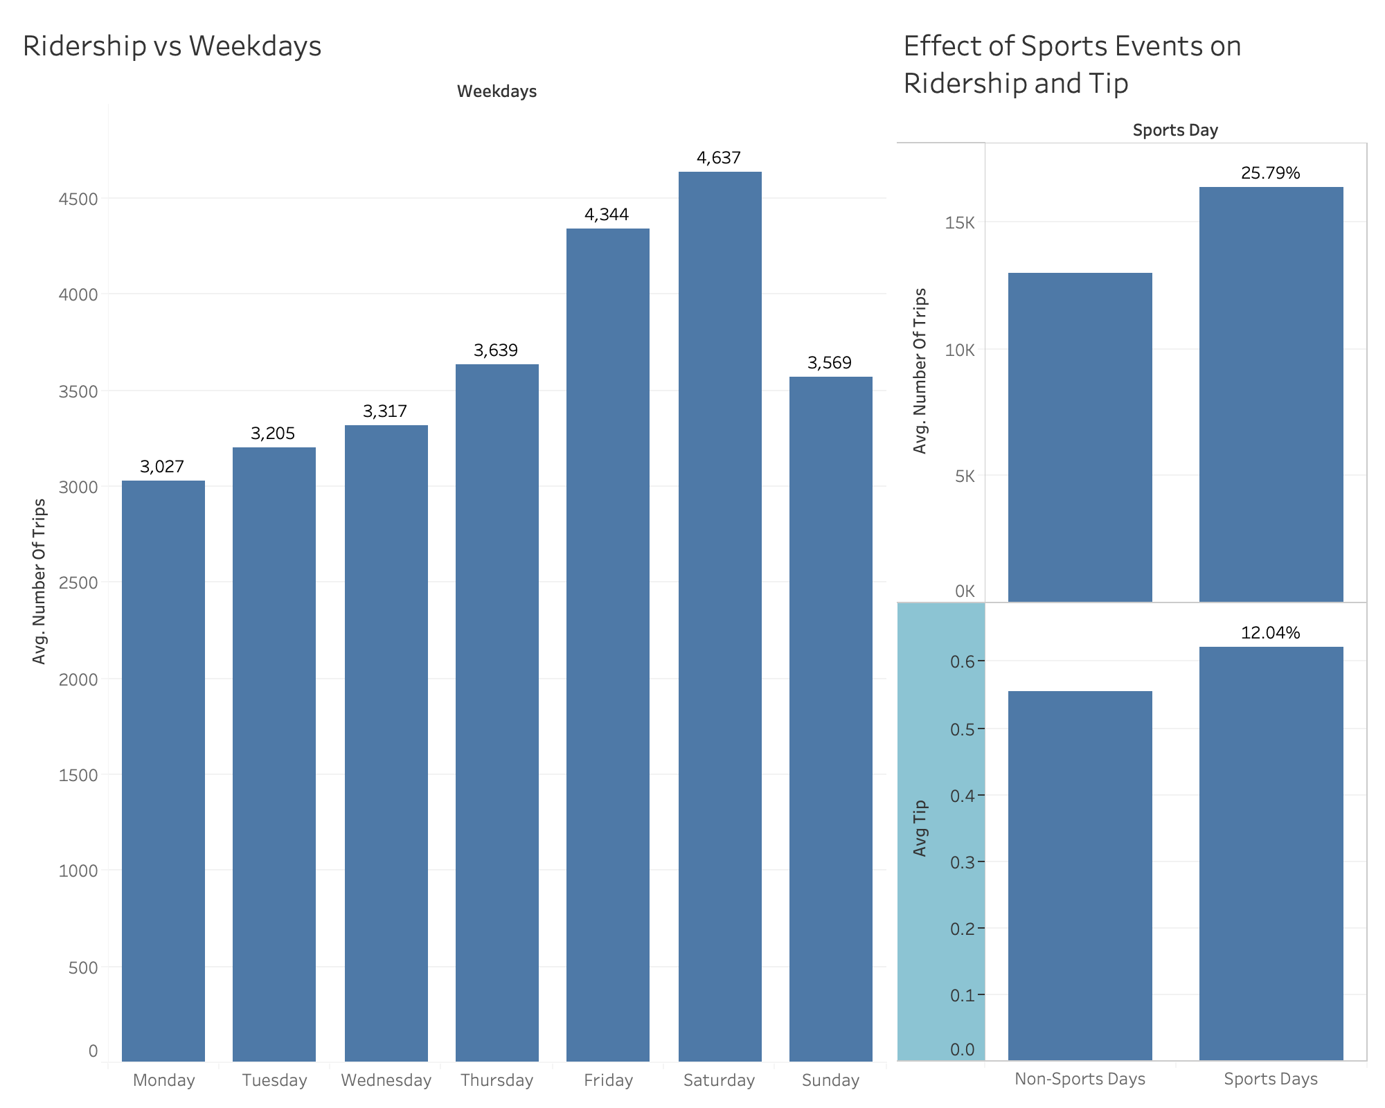
Dashboard: xxx

Slide 19
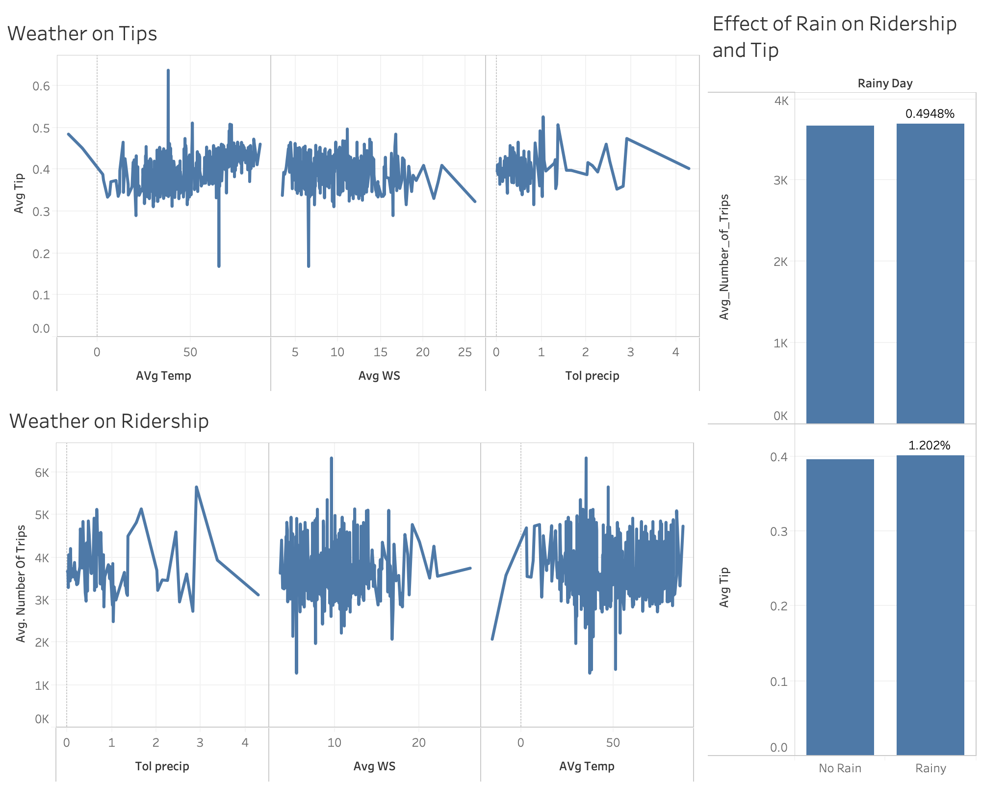
Dashboard: xxx

Slide 20
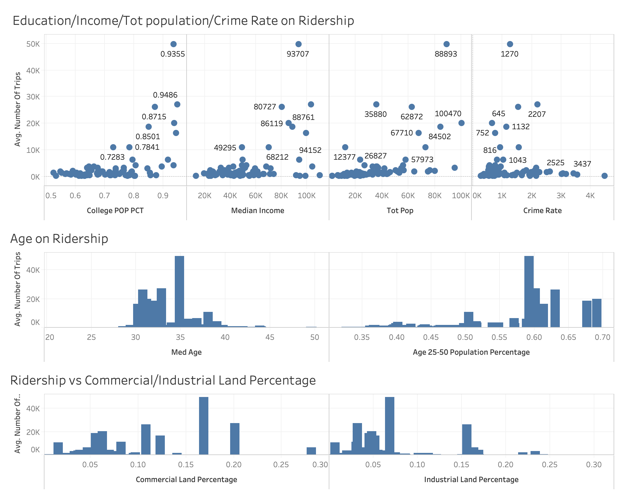
Dashboard: xxx

Slide 21
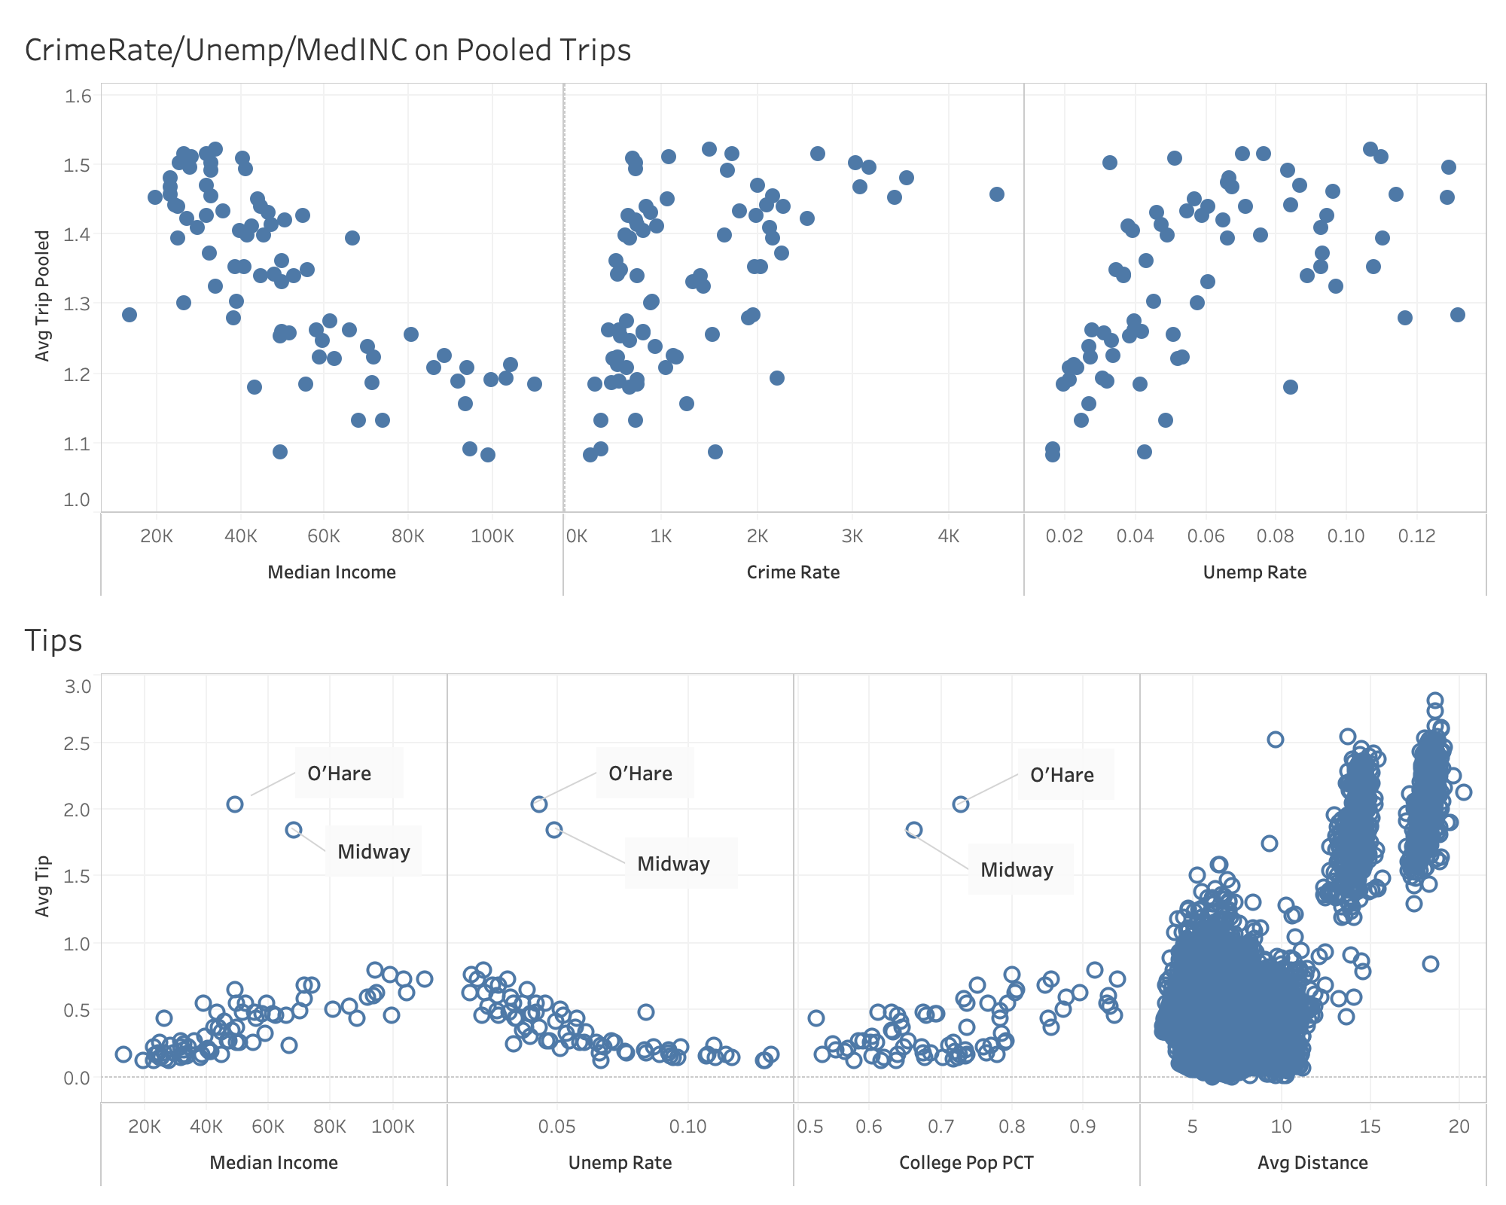
Dashboard: xxx

Slide 22
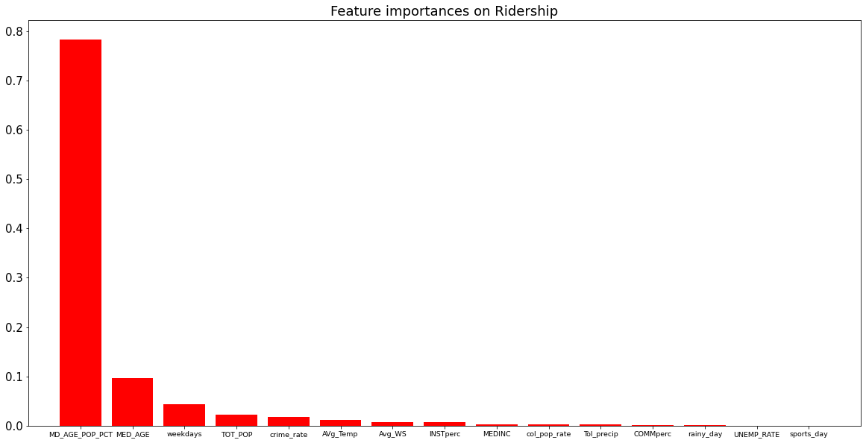
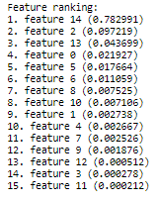
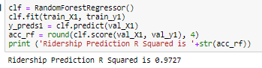
Random Forest Regressor
Important Features

Slide 23
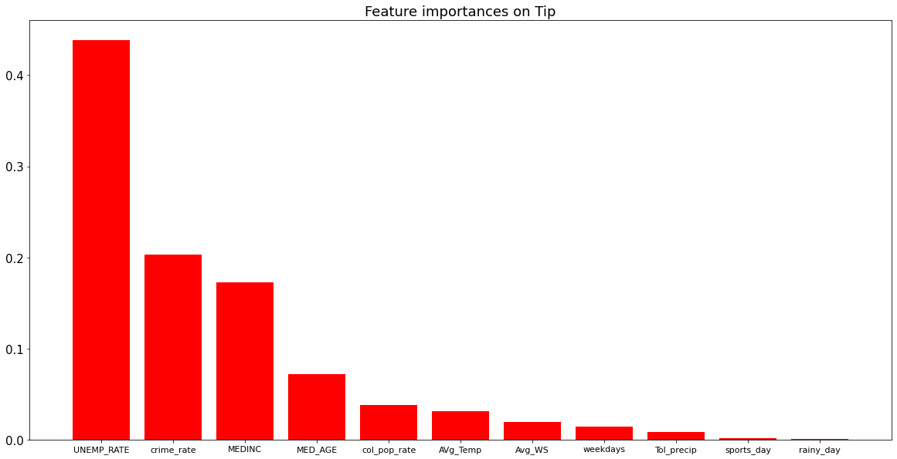
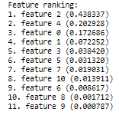
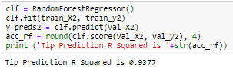
Random Forest Regressor
Important Features

Slide 24
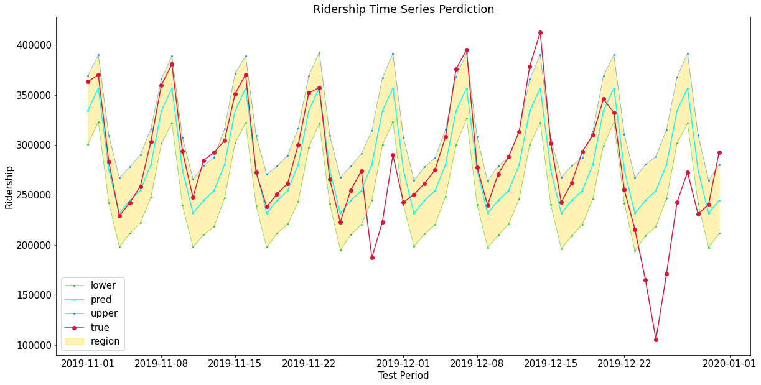
Time Series Forecast
(Facebook Prophet)

Slide 25
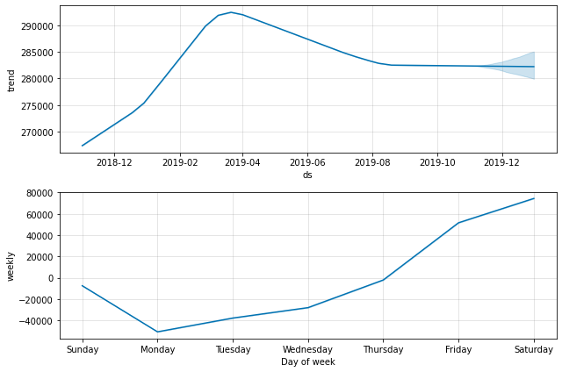
Time Series Forecast
(Facebook Prophet)
Facebook Prophet produces same weekly pattern as our analysis

Slide 26
RECOMMENDATIONS

Slide 27
Conclusion / Recommendation
Ridership and Tips are independent of weather.
Airport customers tend to tip exceptionally better and travel longer distances.
CCA with better economic and education statistics tend to utilize more services and tip better.
TNP companies allocate more vehicles in the business and college districts
Ridership increases towards weekend and peaks on Fridays and Saturdays.
Ridership also peaks in the mid-day.
Encourage drivers to participate during weekends and mid-day by lowering commission

Slide 28
Conclusion / Recommendation
Customers between age 25 and 40 are the biggest base for TNP.
Marketing Campaign target on this age group
Increasing TNP awareness among other age groups.
On sports days, ridership increase about 25% in the home game CCA.
Encourage drivers to move to sports home arena CCAs on sports days
Neighborhoods with higher crime rates have worse economic and educational status, people tend to do more pooled trips.
Increase wait time limit in high crime Neighborhoods for customers’ safety

Slide 29
Future work

Slide 30
Future Work
Ridership forecast can be more accurate with data from 2020 and will take into the consideration of Covid-19
Ridership and Tips should be analyzed with more attributes, like public transportation distribution and major facilities location, etc.
Our initial intuition does not match the analysis result. Machine Learning and Statistical Analysis should be applied with a larger range of dimensions to select a better set of predictors
During discovery and data preparation phase, a closer analysis should be applied to determine whether there is enough information in the data to meet our analytical goal

Slide 31
THANK YOU! anY QUESTIONS?

Slide 32
appendix

Slide 33
reference
Jonathan Levy. (2018). Transportation Network Providers – Trips [Data File]. Available from Chicago Data Portal: https://data.cityofchicago.org/Transportation/Transportation-Network-Providers-Trips/m6dm-c72p
Menne, Matthew J., Durre I., Korzeniewski B., McNeal S., Thomas K., Yin X., Anthony S., Ray R., Vose R., Gleason B., and Houston T. (2012). Global Historical Climatology Network - Daily (GHCN-Daily), Version 3. [indicate subset used]. NOAA National Climatic Data Center. doi:10.7289/V5D21VHZ [access date]. Available from National Centers for Environmental Information web site: https://www.ncdc.noaa.gov/cdo-web/datasets
City of Chicago. (2013). Boundaries - Community Areas (current). Available from Chicago Data Portal Web Site: https://data.cityofchicago.org/Facilities-Geographic-Boundaries/Boundaries-Community-Areas-current-/cauq-8yn6
Chicago Police Department. (2019). Crimes - 2001 to present [Data File]. Available from Chicago Data Portal Web Site: https://data.cityofchicago.org/Public-Safety/Crimes-2001-to-present/ijzp-q8t2
Chicago Metropolitan Agency for Planning. (2015). Community Data Snapshots Raw Data, June 2019 Release [Data File]. Available from CMAP Data Hub Web Site: https://datahub.cmap.illinois.gov/dataset/community-data-snapshots-raw-data
2018-19 Chicago Bulls Schedule. (n.d.). Retrieved from https://www.espn.com/nba/team/schedule/_/name/chi/season/2019/seasontype/1
Chicago Bears NFL - Bears News, Scores, Stats, Rumors & More. (n.d.). Retrieved from https://www.espn.com/nfl/team/_/name/chi/chicago-bears
Chicago Cubs Baseball - Cubs News, Scores, Stats, Rumors & More. (n.d.). Retrieved from https://www.espn.com/mlb/team/_/name/chc/chicago-cubs
Chicago White Sox Baseball - White Sox News, Scores, Stats, Rumors & More. (n.d.). Retrieved from https://www.espn.com/mlb/team/_/name/chw/chicago-white-sox

Slide 34
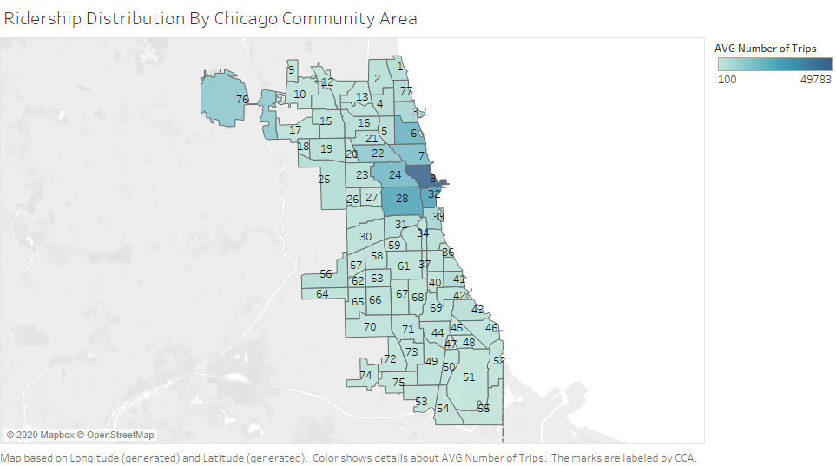

Slide 35
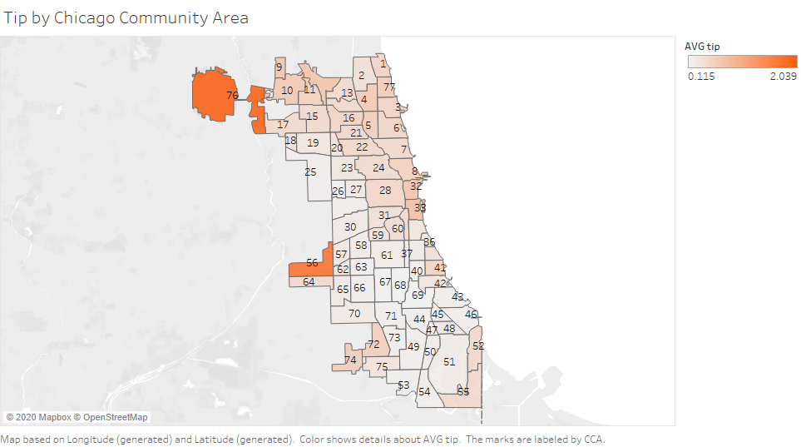
Tip are higher in CCA where O’hare international airport and Midway airport are located
Neighborhoods with higher income tip better

Slide 36
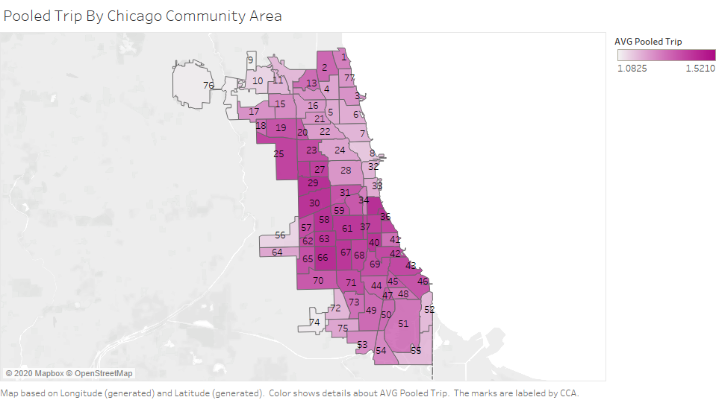
Carpool are used more in west and south lower income neighborhoods of Chicago.

Slide 37
Higher number of trips at daytime
Rapid decline from 2-3pm might due to rush hour or data gap
Higher tips from 5-7am, reason might be morning arrival or departure flight
No significant difference for carpool over 24hr period

Slide 38
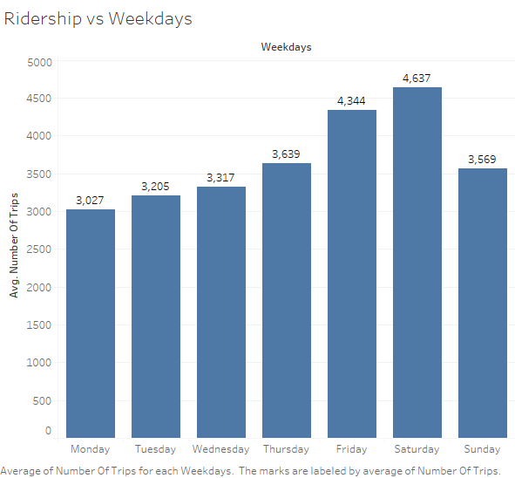
Friday and Saturday have the most ridership due to the coming of weekends.

Slide 39

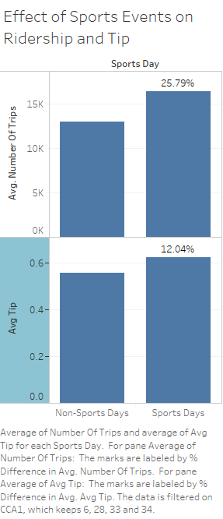
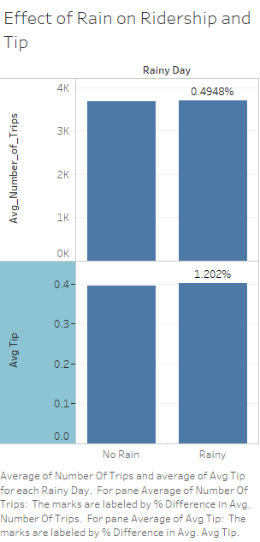
Higher Number of Trips and Tips during sports event days
No significant difference in Number of trips and Tips among rainy day

Slide 40
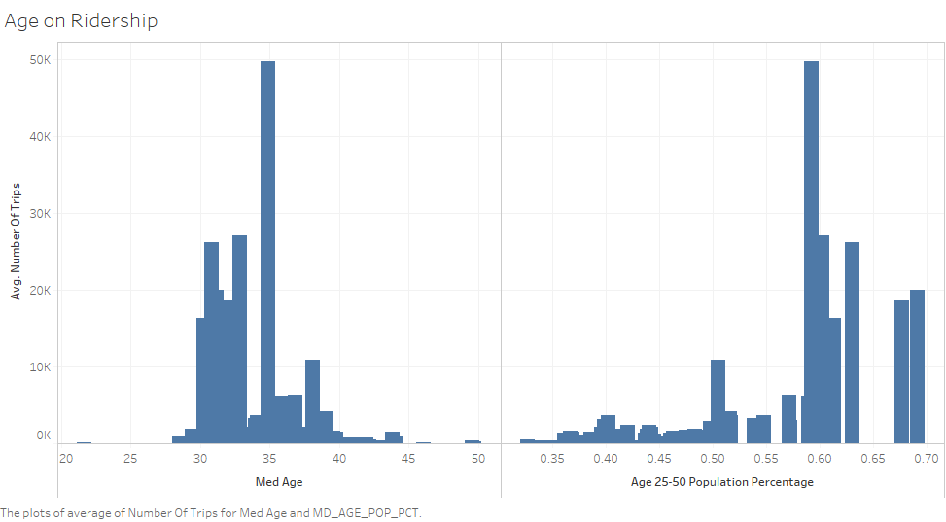
Most customers are those age between 25 to 40

Slide 41
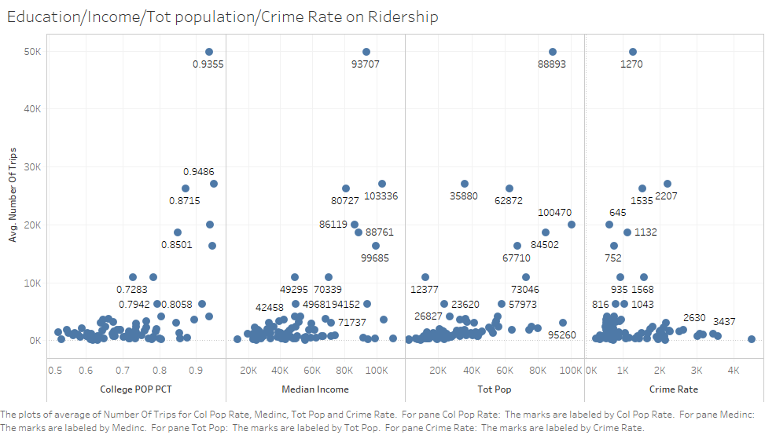
Higher Education -> More Trips
Higher Population -> More Trips
Higher Income -> More Trips
Higher Crime Rate -> Fewer Trips

Slide 42
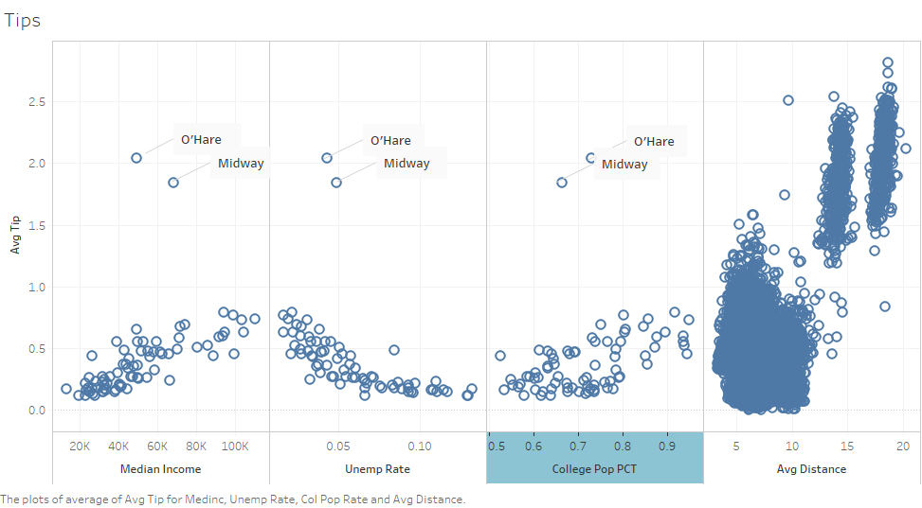
Higher Income -> Higher Tips
Higher Education -> Higher Tips
Higher unemployment rate -> Less Tips
Longer Distance -> Higher Tips
Explaining higher tips in O’Hare and Midway airport

Slide 43
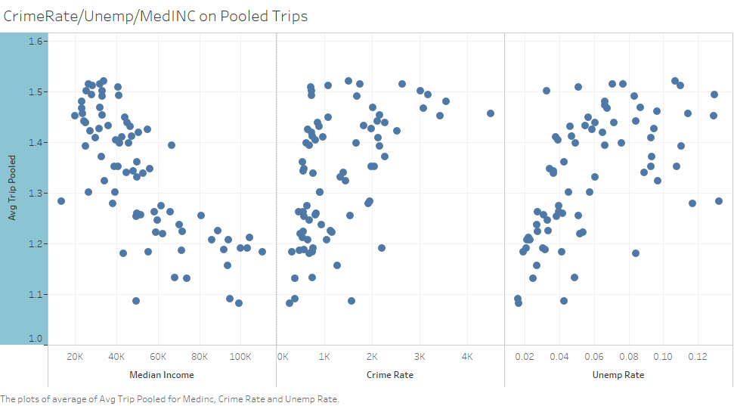
Lower Income -> More Carpool
High unemployment rate -> More Carpool
Higher Crime Rate -> More Carpool

Slide 44
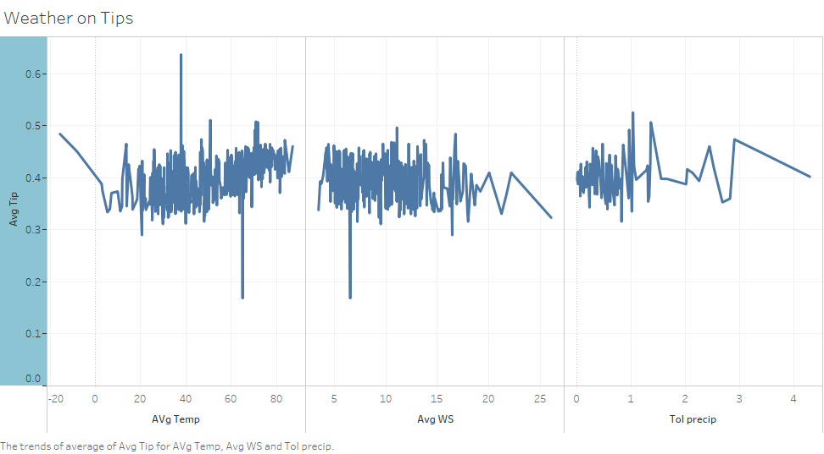
No significant difference among avg temperature, avg windspeed and total precipitation over tip.

Slide 45
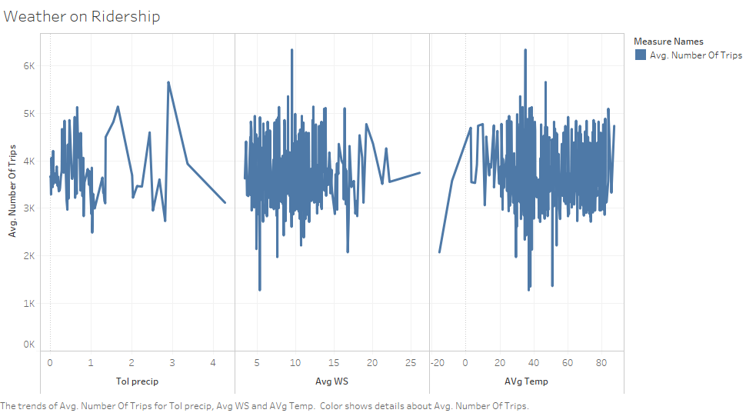
No significant difference among avg temperature, avg windspeed and total precipitation over number of trips.

